Slide 1
Multiple Regression
Analysis: OLS Asymptotics

Slide 2
Multiple Regression
Analysis: OLS Asymptotics
So far we focused on properties of OLS that hold for any sample
Properties of OLS that hold for any sample/sample size
  Expected values/unbiasedness under MLR.1 – MLR.4
  Variance formulas under MLR.1 – MLR.5
  Gauss-Markov Theorem under MLR.1 – MLR.5
  Exact sampling distributions/tests under MLR.1 – MLR.6
Properties of OLS that hold in large samples
  Consistency under MLR.1 – MLR.4
  Asymptotic normality/tests under MLR.1 – MLR.5
Without assuming nor-mality of the error term!

Slide 3





Multiple Regression
Analysis: OLS Asymptotics
Consistency
Interpretation:
  Consistency means that the probability that the estimate is arbitrari- ly close to the true population value can be made arbitrarily high by increasing the sample size
Consistency is a minimum requirement for sensible estimators
An estimator is consistent for a population parameter if
for arbitrary and .
Alternative notation:
The estimate converges in proba-bility to the true population value

Slide 4


Multiple Regression
Analysis: OLS Asymptotics
Theorem 5.1 (Consistency of OLS)
Special case of simple regression model
Assumption MLR.4‘
One can see that the slope estimate is consistent if the explanatory variable is exogenous, i.e. un-correlated with the error term.
All explanatory variables must be uncorrelated with the error term. This assumption is weaker than the zero conditional mean assumption MLR.4.

Slide 5
Multiple Regression
Analysis: OLS Asymptotics
For consistency of OLS, only the weaker MLR.4‘ is needed
Asymptotic analog of omitted variable bias
True model
Misspecified model
Bias
There is no omitted variable bias if the omitted variable is irrelevant or uncorrelated with the included variable

Slide 6


Multiple Regression
Analysis: OLS Asymptotics
Asymptotic normality and large sample inference
  In practice, the normality assumption MLR.6 is often questionable
  If MLR.6 does not hold, the results of t- or F-tests may be wrong
  Fortunately, F- and t-tests still work if the sample size is large enough
  Also, OLS estimates are normal in large samples even without MLR.6
Theorem 5.2 (Asymptotic normality of OLS)
Under assumptions MLR.1 – MLR.5:
In large samples, the standardized estimates are normally distributed
also

Slide 7
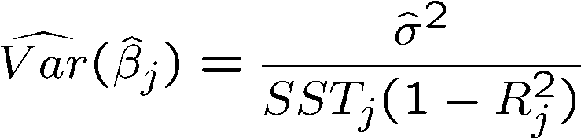


Multiple Regression
Analysis: OLS Asymptotics
Practical consequences
  In large samples, the t-distribution is close to the Normal(0,1) distribution
  As a consequence, t-tests are valid in large samples without MLR.6
  The same is true for confidence intervals and F-tests
  Important: MLR.1 – MLR.5 are still necessary, esp. homoskedasticity
Asymptotic analysis of the OLS sampling errors
Converges to
Converges to
Converges to a fixed number

Slide 8




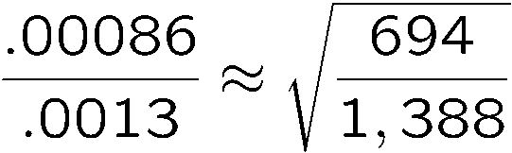
Multiple Regression
Analysis: OLS Asymptotics
Asymptotic analysis of the OLS sampling errors (cont.)
This is why large samples are better
Example: Standard errors in a birth weight equation
shrinks with the rate
shrinks with the rate
Use only the first half of observations

